Slide 1
(Current) Data Analysis Methods MSc Program 2018
Boris Mirkin
Борис Григорьевич Миркин
Professor, Data Analysis and AI, NRU HSE, Moscow, bmirkin@hse.ru, 8(963)-7234021
Professor Emeritus, Computer Science, Birkbeck UL, London, mirkin@dcs.bbk.ac.uk

Slide 2
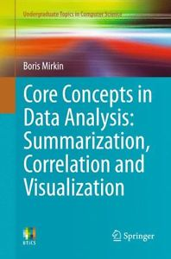
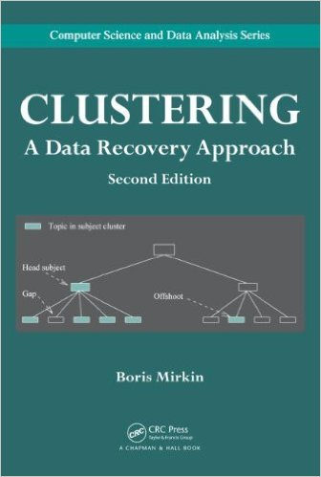
Published 2011

Slide 3

First Part: B. Mirkin “Introductory Data Analysis”, in Russian, 2014/5/6/7/8
Fifty jokes on the subject like:
100% of the Russians answered “Yes” to the question “Are you internet user?”. A result of a recent survey of internet users.
Radio: “It is 2pm in Moscow, 3 pm in Samara, 5pm in Novosi-birsk, 8pm in Irkutsk, 11pm in Khabarovsk, and Mid-night in P-on-Kamchatka.”
Listener: “What a mess in the
country!”

Slide 4
Administration: Lectures and Labs
Two modules (all of the Fall 2018)
In-class Exam Paper (EP) in the end of December
Individual home-work (HW): A report over
A dataset of at least 100 objects and 7 features taken from Internet or any other way (source must be indicated)- must be approved by me. May be a team, up to 3 individuals.
6-8 Home assignments based on lectures including code (any language, including libraries), application of a method and comments/interpretation of the result(s).

Slide 5
Plan of the class (bird’s eye view)
Clustering
Partition
Hierarchies (if time permits)
Methods for interpretation and data analytics
Similarity data clustering
Consensus clustering (if time permits)
SVD and Principal Component Analysis
Hidden factor
Data visualization
Latent Semantic Indexing (if time permits)
Regression, Decision Tree, Naive Bayes

Slide 6
Generic Home-Work
A1 Starting Report: Data Description
A2: K-means clustering
A3: Cluster Interpretation
A4: Contingency Table Analysis
A5 PCA: Hidden Factor & Data Visualization
A6: 2D Regression

Slide 7
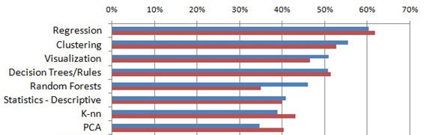
Top Data Science methods used 2017 https://www.kdnuggets.com/
+
+
+
+
+
+

Slide 8
Data Analysis versus Machine Learning:
DA: Using data for enhancing knowledge of the domain
ML: to equip computers with methods and rules to see the target by using data
HUGE OVERLAP
Example of difference: Neural-Net∈ML–DA
Good for robot to prevent an explosion
Bad for lawyer to build their case

Slide 9
Difficulty of this class:
Subject is yet in the making
Spoken English
Full of mathematics and computation, but differs from either
Requires from the student not just thinking, but decision making too

Slide 10
Two examples of successful data analysis
Pluto: a Planet?
Planetary motion: J. Kepler’s 3d law

Slide 11
Planets
in 2006.

Slide 12
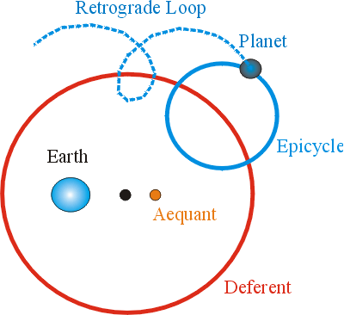
Planetary Motion: Example of Small-Data Analysis Double success 1
A History of Laws for planetary motion
Double success Ptolemy (c. 150 a. d.):
Sun and planets
circle Earth
Does not match data well

Slide 13
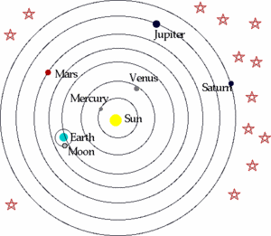
Example of Small-Data Analysis Double success 2
The History of Laws for planetary motion
Copernicus
(c. 1540):
Planets circle Sun
Does not match data well
either

Slide 14
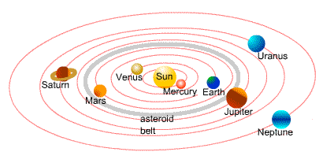
Example of Small-Data Analysis Double success 3
0th Law: All planets move in the same plane
Laws for planetary motion: J. Kepler (c. 1605):
1st Law: Planets revolve Sun in ellipses (ovals)
2^{d} Law: Speed changes – the further away from Sun, the slower (equal sectors in time unit)
Does either

Slide 15
Example of Small-Data Analysis Double success 4
Planet | Period (year) | Distance (average, relative to that of Earth)
Mercury Venus Earth Mars Jupiter Saturn Uranus Neptune Pluto | 0.241 0.615 1.00 1.88 11.8 29.5 84.0 165 248 | 0.39 0.72 1.00 1.52 5.20 9.54 19.18 30.06 39.44
3^{d} Law:
Is there any relation between speed/period and distance?

Slide 16
Example of Small Data Analysis Double success 5
3^{d} Kepler’s Law:
Is there any relation between speed/period and distance?
Fit no line…

Slide 17
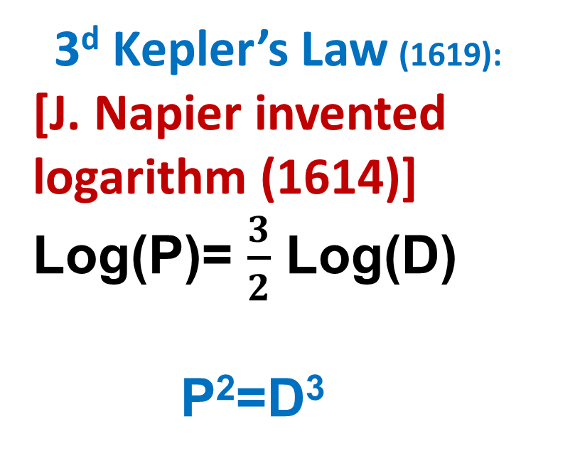
Example of Small Data Analysis Double success 6
3^{d} Kepler’s Law (1619):
[J. Napier invented logarithm (1614)]
Log(P)= $\frac{3}{2}$ Log(D)
P²=D³

Slide 18
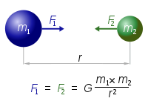
Double success 7
Three Kepler’s Laws: What is so grand?
Substantiated theoretically by
R. Hooke (1635-1703) and I. Newton (1642-1727)
UNIVERSAL GRAVITATION LAW
Mathematical equation, cornerstone of the science

Slide 19
Core Data Analysis: 2 tasks x 2 forms
Quantitative
Principal component analysis
Summarization
Categorical
TODAY Cluster analysis
Quantitative
Regression analysis
Correlation
Categorical
Decision tree

Slide 20
What is data?
Table
Signal
Text
Sequence
Map
Image
Video
…….
This class concentrates on data tables as
generic, simplest, and best explored object

Slide 21
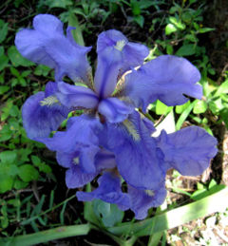
Anderson–Fisher Iris Dataset
Iris flower
Sepal / Чашелистик
Petal / Лепесток
150×4 data of three taxa:
Taxon
1-50 Iris setosa (diploid)
51-100 Iris versicolor (tetraploid)
101-150 Iris virginica (hexaploid)
Features
W1 Sepal length
W2 Sepal width
W3 Petal length
W4 Petal width

Slide 22
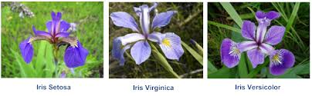
Three Iris taxa: Setosa Virginica Versicolor

Slide 23
Week1. Data case : Iris, most popular dataset
# | Iris setosa | Iris versicolor | Iris virginica
 | w1 w2 w3 w4 | w1 w2 w3 w4 | w1 w2 w3 w4
1 2 3 4 5 6 7 8 9 … 50 | 5.1 3.5 1.4 0.3 4.4 3.2 1.3 0.2 4.4 3.0 1.3 0.2 5.0 3.5 1.6 0.6 5.1 3.8 1.6 0.2 4.9 3.1 1.5 0.2 5.0 3.2 1.2 0.2 4.6 3.2 1.4 0.2 5.0 3.3 1.4 0.2 5.1 3.5 1.4 0.2 | 6.4 3.2 4.5 1.5 5.5 2.4 3.8 1.1 5.7 2.9 4.2 1.3 5.7 3.0 4.2 1.2 5.6 2.9 3.6 1.3 7.0 3.2 4.7 1.4 6.8 2.8 4.8 1.4 6.1 2.8 4.7 1.2 4.9 2.4 3.3 1.0 6.0 2.2 4.0 1.0 | 6.3 3.3 6.0 2.5 6.7 3.3 5.7 2.1 7.2 3.6 6.1 2.5 7.7 3.8 6.7 2.2 7.2 3.0 5.8 1.6 7.4 2.8 6.1 1.9 7.6 3.0 6.6 2.1 7.7 2.8 6.7 2.0 6.2 3.4 5.4 2.3 6.5 3.2 5.1 2.0
What type of analysis to do?

Slide 24
Iris data analysis subjects (1I):
Iris 2
# | I Iris setosa | II Iris versicolor | III Iris virginica
 | w1 w2 w3 w4 | w1 w2 w3 w4 | w1 w2 w3 w4
1 2 3 4 5 6 7 8 9 50 | 5.1 3.5 1.4 0.3 4.4 3.2 1.3 0.2 4.4 3.0 1.3 0.2 5.0 3.5 1.6 0.6 5.1 3.8 1.6 0.2 4.9 3.1 1.5 0.2 5.0 3.2 1.2 0.2 4.6 3.2 1.4 0.2 5.0 3.3 1.4 0.2 5.1 3.5 1.4 0.2 | 6.4 3.2 4.5 1.5 5.5 2.4 3.8 1.1 5.7 2.9 4.2 1.3 5.7 3.0 4.2 1.2 5.6 2.9 3.6 1.3 7.0 3.2 4.7 1.4 6.8 2.8 4.8 1.4 6.1 2.8 4.7 1.2 4.9 2.4 3.3 1.0 6.0 2.2 4.0 1.0 | 6.3 3.3 6.0 2.5 6.7 3.3 5.7 2.1 7.2 3.6 6.1 2.5 7.7 3.8 6.7 2.2 7.2 3.0 5.8 1.6 7.4 2.8 6.1 1.9 7.6 3.0 6.6 2.1 7.7 2.8 6.7 2.0 6.2 3.4 5.4 2.3 6.5 3.2 5.1 2.0
- Visualise data: map similar specimens at points near each other; dissimilar specimens, at far away points
- Build a predictor of sepal sizes from the petal sizes (say, to lessen the burden of measurement)

Slide 25
Iris data analysis subjects (1):
Iris 2
# | I Iris setosa | II Iris versicolor | III Iris virginica
 | w1 w2 w3 w4 | w1 w2 w3 w4 | w1 w2 w3 w4
1 2 3 4 5 6 7 8 9 50 | 5.1 3.5 1.4 0.3 4.4 3.2 1.3 0.2 4.4 3.0 1.3 0.2 5.0 3.5 1.6 0.6 5.1 3.8 1.6 0.2 4.9 3.1 1.5 0.2 5.0 3.2 1.2 0.2 4.6 3.2 1.4 0.2 5.0 3.3 1.4 0.2 5.1 3.5 1.4 0.2 | 6.4 3.2 4.5 1.5 5.5 2.4 3.8 1.1 5.7 2.9 4.2 1.3 5.7 3.0 4.2 1.2 5.6 2.9 3.6 1.3 7.0 3.2 4.7 1.4 6.8 2.8 4.8 1.4 6.1 2.8 4.7 1.2 4.9 2.4 3.3 1.0 6.0 2.2 4.0 1.0 | 6.3 3.3 6.0 2.5 6.7 3.3 5.7 2.1 7.2 3.6 6.1 2.5 7.7 3.8 6.7 2.2 7.2 3.0 5.8 1.6 7.4 2.8 6.1 1.9 7.6 3.0 6.6 2.1 7.7 2.8 6.7 2.0 6.2 3.4 5.4 2.3 6.5 3.2 5.1 2.0
- Build a predictor of taxa (classifier) based on the petal/sepal sizes
Check how much features W1—W4 are relevant (for example, by making clusters and comparing them to the taxa)

Slide 26
Iris dataset structure: 2D visualized with MATLAB
* =
Left: >>subplot(1,2,1); plot(z1, z2, ‘k.’);
Right: >>subplot(1,2,2);
>>plot(z1(1:50),z2(1:50),'g+',z1(51:100),z2(51:100),'ro',z1(101:150),z2(101:150),'bd');

Slide 27
Clustering What is clustering:
Yes No
Cluster: a cohesive subset of entities:
within-cluster similarities > those outside of the cluster.
Clustering is a set of methods for finding clusters and
cluster structures in data.
DA clustering: also describing clusters; yellow cluster
on the left: a1≤ x ≤a2 & b1≤ y ≤b2

Slide 28
Clustering What is clustering, 2
Different perspectives at clustering
Machine learning: Unsupervised pattern learning
Data Analysis: Finding cluster structures in data
Core Data Analysis: Hidden nominal factor analysis
Knowledge Discovery: Classification building

Slide 29
Clustering What is clustering, 3
Data Analysis: Finding and describing cluster structures in data. Main cluster structures:
Individual cluster:
detecting a community in a network
determining a subset of proteins similar to a query protein
subset of documents with a common theme
Cluster partition:
division of population over different life styles
grouping of territories in economic regions
partitioning of an image in homogeneous segments
Cluster hierarchy:
taxonomy of living organisms
classification of computer science subjects
ontology of concepts in a domain

Slide 30
Clustering What is clustering, 4
Knowledge Discovery: Classification building.
Three main goals of a classification:
Shape and keep knowledge
Analyze the structure of phenomena
Relate different aspects of phenomena
Three goals example of Cluster partition:
division of population over different life styles
Knowledge of life styles
Distribution of population over life styles
Relation between life style, work, family, climate, etc.

Slide 31
Classification is no science SO FAR
In XVII century the great Aristotle and his views were thrown out of the emerging science as something of speculation;
So was the classification, as something of a speculation;
So far, any classification, even if successful, is not science
(e.g. Woese or Mendeleev cases)

Slide 32
Three examples of great classifications and their roles in the progress of humankind:
Tree of Life
Mendeleev’s Periodic Chart
Superposition in Geology
[Try to take a look at Social Classes (by yourself)]

Slide 33
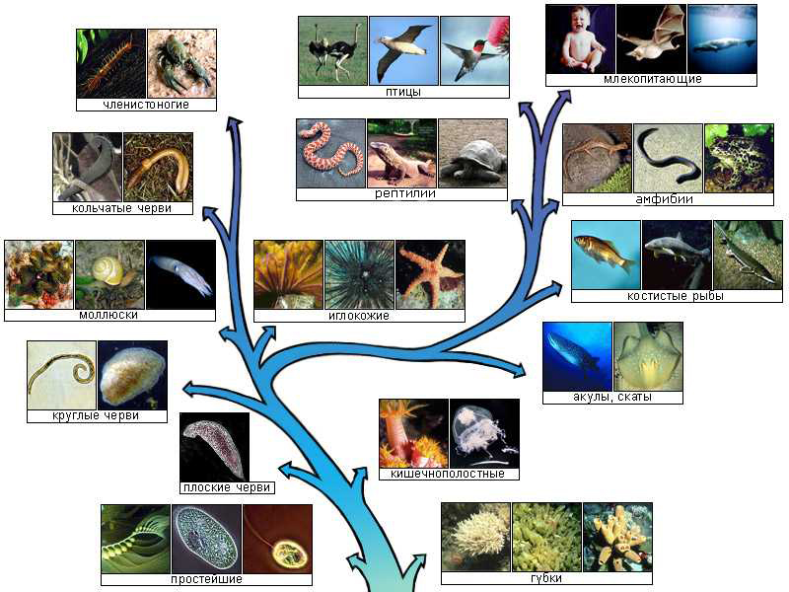
Classification of life (Structure – History)
- Carl Linnaeus (1707-78) A lucky taxonomy (over reproductive organs)
- Charles Darwin (1809-82)
Interpretation of the tree as a model of evolution and survival of the fittest
(Cladistics)

Slide 34
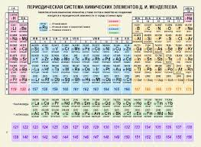
Mendeleev’s Periodic Table
Double classification of:
chemical elements:
Rows (Periods) and
Columns (Groups)
Foundation of
Physics and Chemistry
Position in Table
Physics and Chemical
properties
Modeling structure of atom and molecule

Slide 35
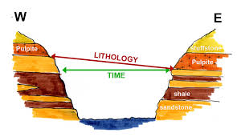
Geology: Superposition [structure] & Correlation [history]
Earth surface (strata))
Superposition:
the deeper
a stratum, the
earlier its
generating
process
Correlation:
Similarity in
geologic
profiles means
similarity in dates

Slide 36
K-Means clustering
Method
Issues
Theoretical development
Partial solutions to the issues

Slide 37
Clustering with K-Means, 1 K-Means iterations illustrated
Cluster k: center c_{k} and set S_{k} (k=1,…, K)
(a) Initialize (b) Assign entities to nearest
center
(c) Cluster update (d) Center update

Slide 38
Clustering with K-Means, 2 K-Means iterations formulated
Cluster k: center c_{k} and set S_{k} (k=1,…, K)
K-Means method:
0. Specify K, number of clusters, and initial centers c_{k} (k=1,…, K)
Update sets S_{k} (k=1,…, K) using Minimum distance rule
Update centers c_{k} (k=1,…, K) as means of S_{k}
If new centers coincide with the previous ones, stop. Else go to 1.

Slide 39
Clustering with K-Means, 3 Explanation of the mean
Let S be in R⁴ and consist of 3 objects
i1 = (2, 1, 2, 0)
i2 = (1, 2, 0, 1)
i3 = (3, 0, 1, 5)
----------------------
Mean: 6/3 3/3 3/3 6/3 Sum/Nk (2, 1, 1, 2)

Slide 40
Clustering with K-Means, 4 Explanation of the distance
Euclidean squared distance:
dot product of the difference by itself
d(i, c_{k})=<i-c_{k},i-c_{k} >
object i = (2, 1, 2, 0)
center c_{k} = (1, 2, 0, 1)
i- c_{k}=(2-1, 1-2, 2- 0, 0-1)=(1, -1, 2, -1)
Distance: d(i,c_{k}) =(1)²+(-1)²+(2)²+(-1)² = 7

Slide 41
Clustering with K-Means, 5 Applying K-Means method to Iris dataset
Step −1. Preprocessing (options):
A. No pre-processing (All measurements relate to elements of the same flower and use the same unit)
B. Z-scoring: Each feature centered by its mean and normalized by its standard deviation (Everybody does so)
C. Each feature centered by its mean and normalized by its range (Dividing by range is better than by the standard deviation, Mirkin 2011 – see next slide)

Slide 42

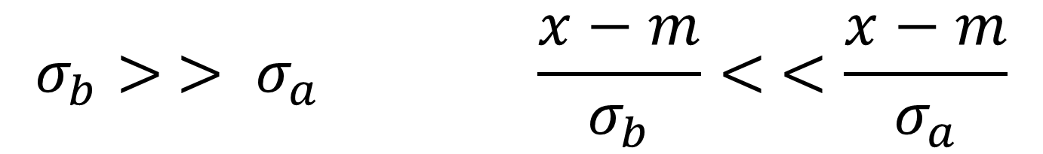
Clustering with K-Means , 6 Why dividing by range can be better than dividing by std for clustering
$$σ_{b}> > σ_{a} \frac{x−m}{σ_{b}}< <\frac{x−m}{σ_{a}}$$
Counter-intuitive: (b) divides dataset, (a) not

Slide 43
Clustering with K-Means,7 Preprocessing options at Iris dataset
0. Specify K=3 and specimens 1, 51, 101 as initial centers (because of preliminary knowledge). Then run iterations of K-Means:
A. (No preprocessing) Converged in 4 iterations
B. (Z scoring) Converged in 7 iterations
C. (Normalizing by range) Converged in 5 iterations

Slide 44
Clustering with K-Means, 8 Confusion regarding Ground Truth
Partition of Iris dataset using K-Means method:
Ground Truth: Taxa T1 T2 T3 Total
A. (No preprocessing) 50 0 0 50 Cl1
16 errors 0 48 14 62 Cl2
0 2 36 38 Cl3
B. (Z scoring) 50 0 0 50 Cl1
28 errors 0 39 17 56 Cl2
0 11 33 44 Cl3
C. (Norm. by range) 50 0 0 50 Cl1
17 errors 0 47 14 61 Cl2
0 3 36 39 Cl3

Slide 45
Clustering with K-Means, 9 Cluster interpretation
Center c_{k} for Interpretation of cluster S_{k}:
Iris taxon T1: Specimens number 1, 2, …, 50
Taxon T1 Interpretation: SMALL PETAL
 | SLength | SWidth | PLength | PWidth
Center | 5.006 | 3.428 | 1.462 | 0.246
Grand mean | 5.843 | 3.057 | 3.758 | 1.199
Difference | −0.837 | 0.371 | −2.296 | −0.953
Difference, % | −14.3 | +12.1 | −61.1 | −79.5

Slide 46
Clustering with K-Means, 10 Advantages
K-Means computations model typology making (who knows: what is typology?)
Computation is intuitive
Computation is fast and requires no additional memory
Computation is easy to parallelize (big data)

Slide 47
Clustering with K-Means, 11 Issues of K-Means
Would the K-Means computations ever stop?
Results depend of the initialization (see next slide): How should one initialize?
Choosing the number of clusters K?
To address, let us do a bit of theory

Slide 48
Clustering with K-Means, 12 Results heavily depend of the initialization
Two clearly visible
clusters case.
Top:
Reasonable location
of initial centroids
Bottom:
Asymmetric initial centers lead to wrong clustering results

Slide 49
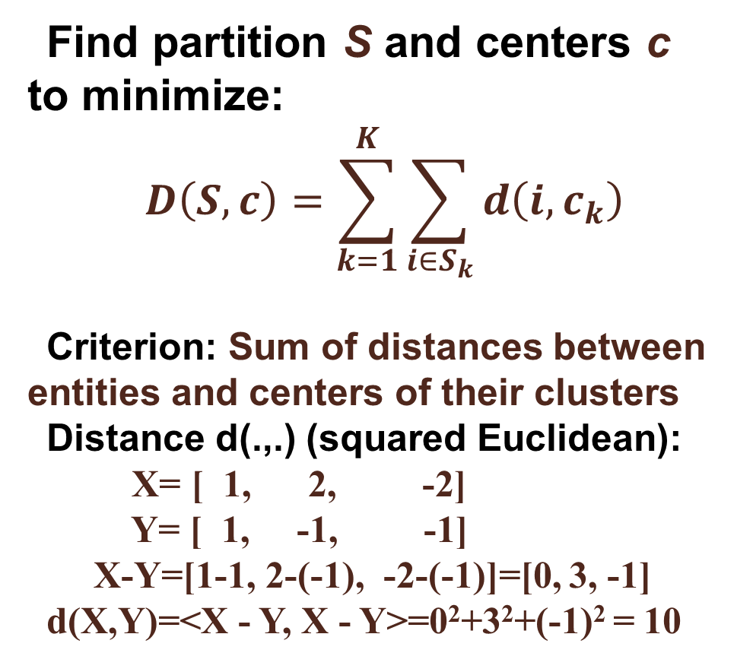
Clustering with K-Means, 13 K-Means criterion:
Find partition S and centers c to minimize:
$$D\left(S,c\right)=\sum_{k=1}^{K}{\sum_{i∈S_{k}}{d\left(i,c_{k}\right)}}$$
Criterion: Sum of distances between entities and centers of their clusters
Distance d(.,.) (squared Euclidean):
X= [ 1, 2, -2]
Y= [ 1, -1, -1]
X-Y=[1-1, 2-(-1), -2-(-1)]=[0, 3, -1]
d(X,Y)=<X - Y, X - Y>=0²+3²+(-1)² = 10

Slide 50
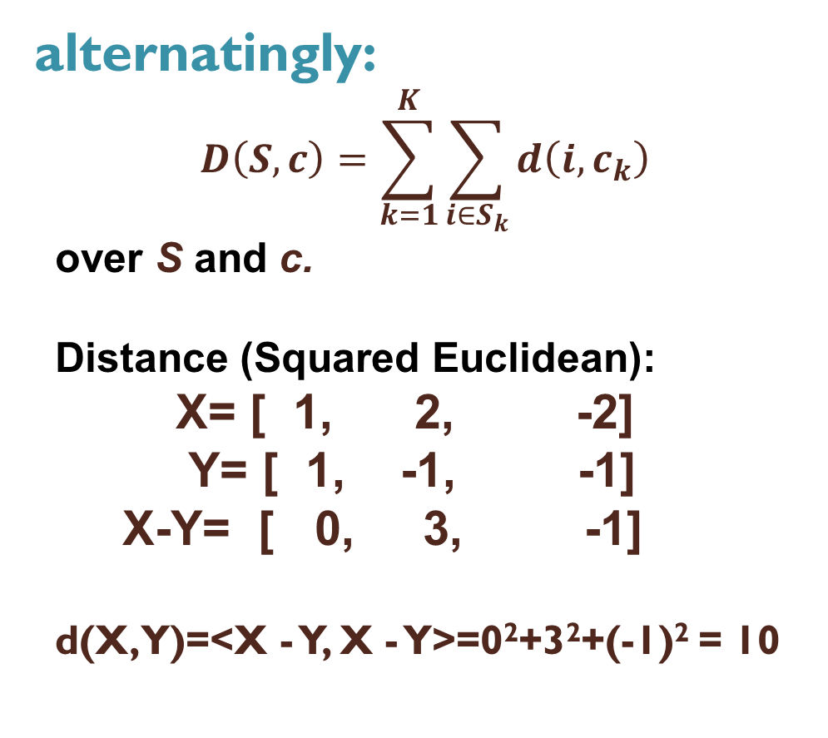
Clustering with K-Means, 14 K-Means computation converges
Minimize D(S,c)
Min_{S} D(S, c):
- Clusters update
Min_{c} D(S, c):
- Centers update
D(S,c) decreases at each step:
Convergence – why? (QUIZ)
alternatingly:
$$D\left(S,c\right)=\sum_{k=1}^{K}{\sum_{i∈S_{k}}{d\left(i,c_{k}\right)}}$$
over S and c.
Distance (Squared Euclidean):
X= [ 1, 2, -2]
Y= [ 1, -1, -1]
X-Y= [ 0, 3, -1]
d(X,Y)=<X - Y, X - Y>=0²+3²+(-1)² = 10

Slide 51
Pythagorean decomposition
K-Means criterion:
T = F(S,c) + D(S,c)
Data_Scatter = “Explained Part”+”Unexplained Part”

Slide 52
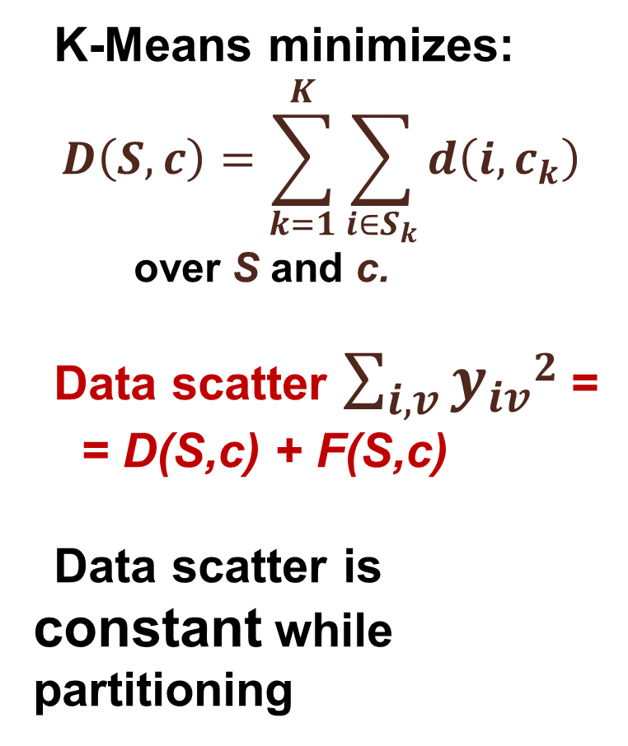
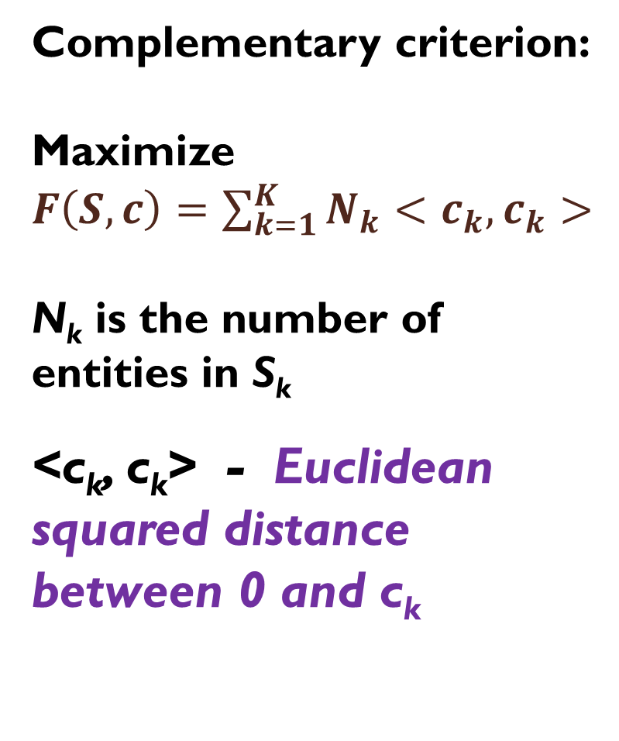
Complementary clustering criterion
K-Means minimizes:
$$D\left(S,c\right)=\sum_{k=1}^{K}{\sum_{i∈S_{k}}{d\left(i,c_{k}\right)}}$$
over S and c.
Data scatter $\sum_{i,v}{y_{iv}2}$ =
= D(S,c) + F(S,c)
Data scatter is constant while partitioning
Complementary criterion:
Maximize
$F\left(S,c\right)=\sum_{k=1}^{K}{N_{k}<c_{k},c_{k}>}$
N_{k} is the number of entities in S_{k}
<c_{k}, c_{k}> - Euclidean squared distance between 0 and c_{k}

Slide 53
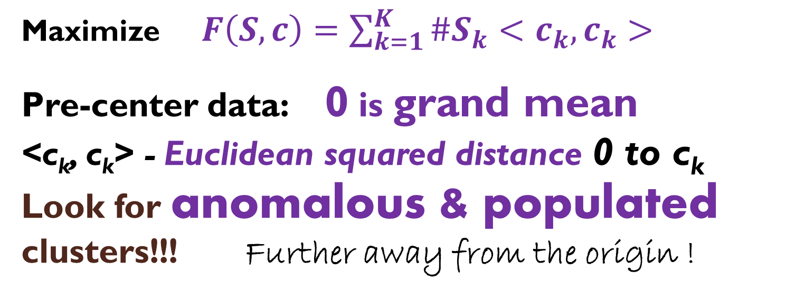
K-Means complementary criterion
Maximize $F\left(S,c\right)=\sum_{k=1}^{K}{{\#S}_{k}<c_{k},c_{k}>}$
Pre-center data: 0 is grand mean
<c_{k}, c_{k}> - Euclidean squared distance 0 to c_{k} Look for anomalous & populated clusters!!! Further away from the origin !

Slide 54
Determining the Number of clusters: Two ways
A) Extract clusters one-by-one: find an anomalous cluster, then remove it; etc.
B) Determine centers/objects, both most distant and representative, in parallel; then k-means
(a subject of current investigation)
First
Second

Slide 55
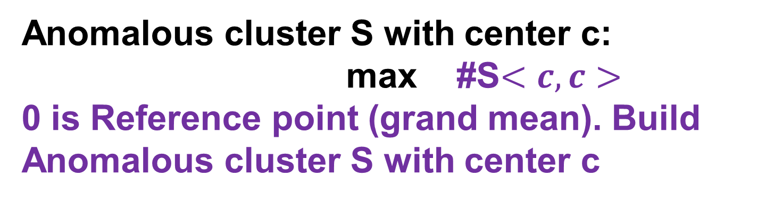
Finding an ANOMALOUS Cluster (Mirkin 1998, Chiang&Mirkin 2010)
Anomalous cluster S with center c:
max #S$<c,c>$
0 is Reference point (grand mean). Build Anomalous cluster S with center c

Slide 56
Finding an Anomalous cluster
1. Initial center c is object, farthest away from 0.
2. Cluster update: If d(y_{i},c)< d(y_{i},0), assign y_{i} to S.
3. Centroid update: Within-S mean c' if c' ≠ c. Go to 2 with c⇐ c'. Otherwise, halt.

Slide 57
Anomalous cluster and K-Means
Anomalous Cluster is (almost) K-Means up to:
(i) the number of clusters K=2: the “anomalous” one and the “main body” of entities around 0;
(ii) center of the “main body” cluster is forcibly always at 0;
(iii) natural initialization: c⁰ is at entity which is the farthest away from 0.

Slide 58
ik-means
Pre-center the data matrix to grand-mean, set threshold for minimal cluster size t ( =1 by default).
Find Anomalous cluster and store its center and size.
Remove the Anomalous cluster from data set. Halt if the dataset gets empty, else: go to 2.
Initialize k-means with centers of those anomalous clusters whose size ≥ t
Extensive experimentation by Chiang and Mirkin (J of Cl, 2010) demonstrated superiority of iK-Means over competition

Slide 59
Clustering with K-Means Anomalous cluster
Anomalous Cluster applied to Iris dataset just centered (no further normalization):
Initial center: the furthest away entity 132
c0=(1.8567 -0.4573 3.1420 1.1007)
- 27 entities are closer to c0 than to 0; their center
c1=(1.1641 0.0390 2.1716 0.9377)
- 47 entities are closer to c1 than to 0; their center
c2=(0.8865 -0.0361 1.8399 0.8156)
- 58 entities are closer to c2 than to 0; their center
c3=(0.7618 -0.0729 1.7023 0.7593)
- 60 entities are closer to c3 than to 0; their center
c4=(0.7600 -0.0773 1.6737 0.7407) convergence

Slide 60
Clustering with K-Means Anomalous cluster iterated
Iris dataset just centered (no further normalization) AC ITERATIVELY to those yet unclustered:
AnomClus 1 What are these?
60 entities c=(0.7600 -0.0773 1.6737 0.7407) 34.6%
AnomClus 2
50 entities c=(-0.8373 0.3707 -2.2960 -0.9533) 51.5%
AnomClus 3
31 entities c=(-0.1853 -0.4122 0.3872 0.0684) 1.6%
AnomClus 4 {67} singleton 0.2%
AnomClus 5 5 entities 0.6%
AnomClus 6 {98} singleton Less 0.1%
AnomClus 7 {99} singleton Less 0.1%
AnomClus 8 {55} singleton Less 0.1%

Slide 61
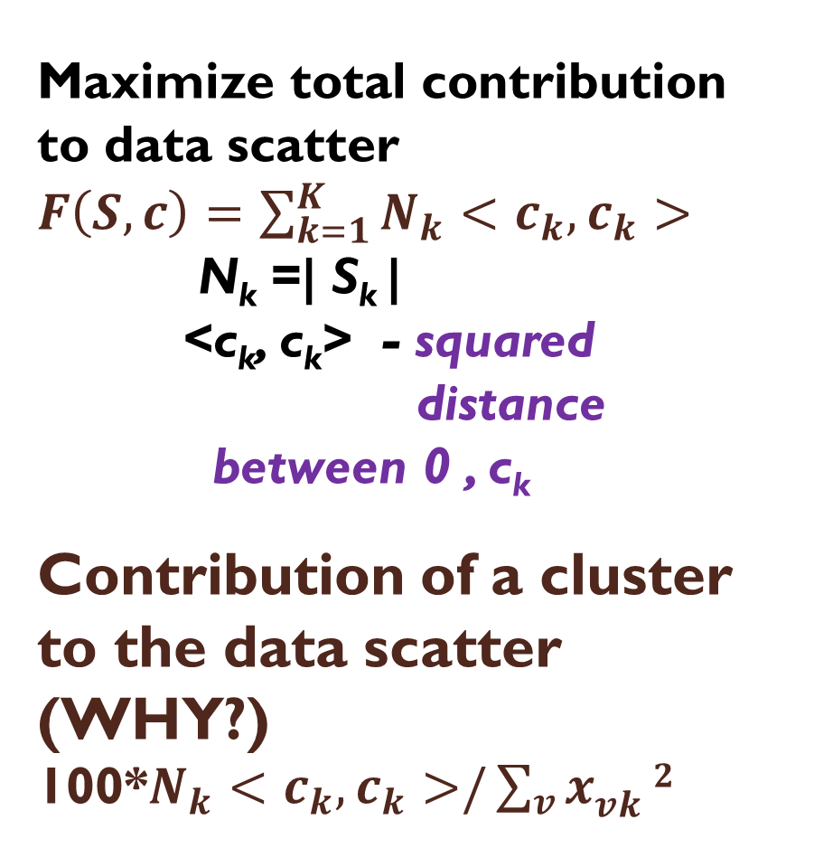
Clustering with K-Means Iterated Anomalous cluster
Maximize total contribution to data scatter
$F\left(S,c\right)=\sum_{k=1}^{K}{N_{k}<c_{k},c_{k}>}$
N_{k} =| S_{k} |
<c_{k}, c_{k}> - squared
distance
between 0 , c_{k}
Contribution of a cluster to the data scatter (WHY?)
100*$N_{k}<c_{k},c_{k}>/\sum_{v}{x_{vk}^{}}2$
Anomalous Cluster
ITERATED :
AnomClus 1
60 entities 34.6%
AnomClus 2
50 entities 51.5% Because the AnomClus 3 algorithm is local
31 entities 1.6%
AnomClus 4 0.2%
AnomClus 5 0.6%
AnomClus 6 Less 0.1%
AnomClus 7 Less 0.1%
AnomClus 8 Less 0.1%

Slide 62
Clustering with K-Means Anomalous cluster and iK-Means
Anomalous Clusters ITERATIVELY :
AnomClus 1
60 entities 34.6%
AnomClus 2
50 entities 51.5%
AnomClus 3
31 entities 1.6%
AnomClus 4 0.2%
AnomClus 5 0.6%
AnomClus 6 Less 0.1%
AnomClus 7 Less 0.1%
AnomClus 8 Less 0.1%
Intelligent K-Means
0. Standardize data by centering and, if needed, normalization
Iteratively find all Anomalous clusters
Choose the largest K among them or, if K is difficult to specify, apply threshold on the minimum cardinality of a cluster (say N_{k}<10 for Iris).
Apply K-Means initialized at chosen Anomalous Cluster centers

Slide 63
Clustering with K-Means at IRIS
1. Anomalous Cluster applied to Iris dataset just centered (no further normalization) ITERATIVELY to those unclustered:
AnomClus 1
60 entities c1=(0.7600 -0.0773 1.6737 0.7407) 34.6%
AnomClus 2
50 entities c2=(-0.8373 0.3707 -2.2960 -0.9533) 51.5%
AnomClus 3
31 entities c3=(-0.1853 -0.4122 0.3872 0.0684) 1.6% Etc.
2. Leave those N_{k} >10: then K=3 and initial centers above.
3. Apply K-Means: Taxa: T1 T2 T3 Total
Cl3 0 47 14 61
14+3=17 errors Cl2 50 0 0 50
Cl1 0 3 36 39

Slide 64
Data analysis versus classical statistics
Area | Data analysis | Classical Statistics
Aim | Finding patterns or regularities in data | Estimate/hypothesize about parameters of a statistical model
Data | Object-to-Feature matrix | Sample from a probabilistic distribution
Problem | Approximate data matrix by “ideal” data | Maximum likelihood
Result | Pattern and quality of its fit to the data | Parameter estimates, hypotheses tested
Findings | Interpretation | Support / Reject

Slide 65
Data analysis versus classical statistics, 1
Area | Data analysis | Classical Statistics
Aim | Finding patterns or regularities in data | Estimate/hypothesize about parameters of a statistical model
Data | Object-to-Feature matrix | Sample from a probabilistic distribution
Feature | Mapping: Set_Objects ⇒ Set_Values | Random variable (density function)

Slide 66
k-means versus mixture of Gaussians, 2
Area | Data analysis | Classical Statistics
Problem | Approximate data points by centers | Maximum Likelihood
Method | K-means | Expectation-Maximization algorithm
Result | Clusters and their centers | Estimate of Mixture of Gaussians/Other
Findings | Interpretation | Interpretation

Slide 67
How to prepare yourself to the next lecture:
After the lecture, put down main concepts that have been discussed in the lecture and think a few minutes of what do they mean
Just before the next lecture: Take a few minutes and look through the slides of the previous lecture

Slide 68
Home work:
1. Each to form/join a team of one, two or three; the team finds a meaningful dataset of their liking on the internet: say, by Googling “data analysis dataset”
Number of entities ≥ 100, of features ≥ 7
No missings
No Irivine ML repository
The dataset is to be approved by me.
2. Start writing a team’s report file
Project title page
Section 1.
Explanation of the choice of the dataset
Information of the dataset: features, number of entities, source address, examples of problems

Slide 69
Review of lecture 1
Intro: administration, etc.
Two examples of successful data analysis:
Planets
3d Kepler’s Law
Core Data Analysis
Iris dataset and some issues to investigate
Clustering: different perspectives
k-means partitioning method; advantages/drawbacks
k-means criterion and its alternating minimization
Complementary criterion; its meaning
Anomalous cluster clustering
Data analysis versus classical mathematical statistics
Home assignment
Advice on getting more from the class

